Slide 1

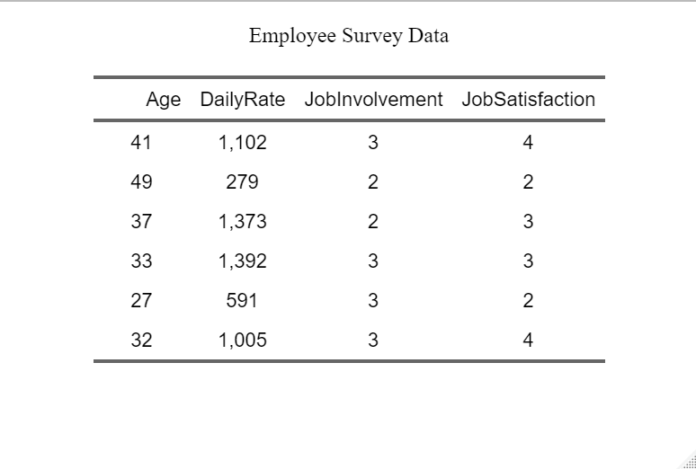
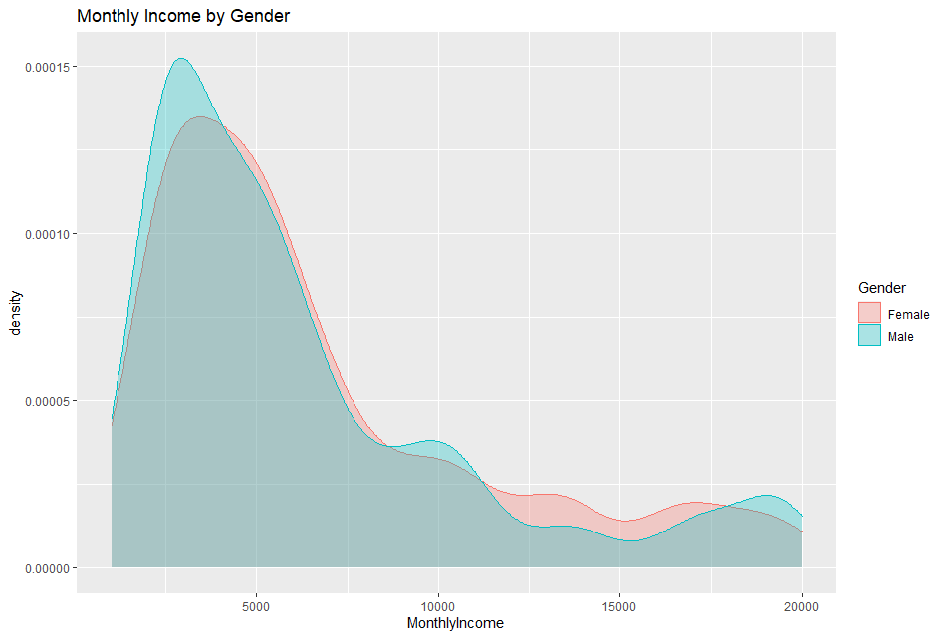
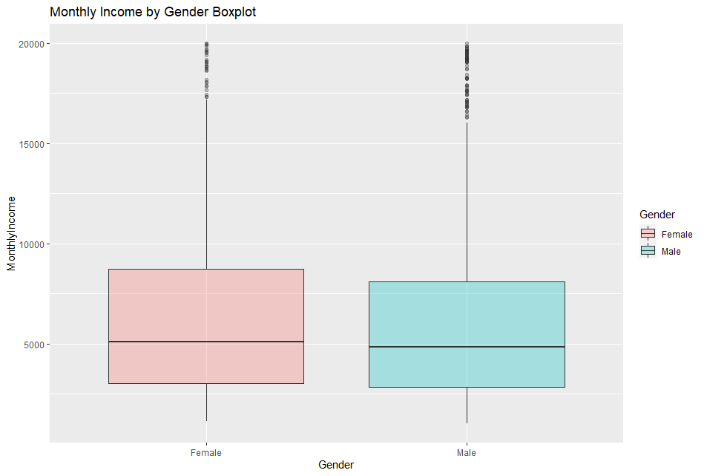
PsychoStat
Describing & Exploring Data

Slide 2
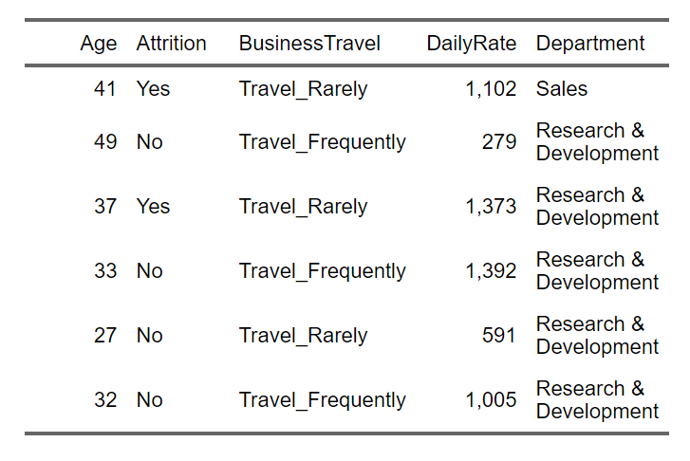

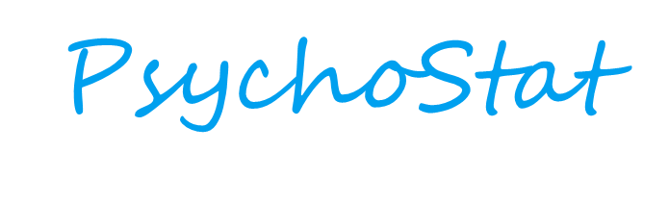
Goal
Explore and describe the characteristics of our sample data
Approach
Visualizations
Summary Statistics
Keywords
Frequency Distributions, Histograms, Kernel Density Plots, Stem & Leaf Plots, Boxplots
Shape
Symmetry, Skew, Modality
Central Tendency
Mean, Median, Mode
Spread/Variability
Variance, Standard Deviation, Quantiles, Quartiles, Percentiles, Range, IQR

Slide 3
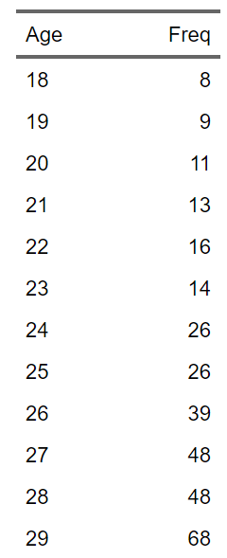
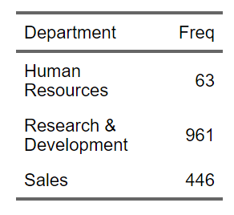
Standards
Visualizing & Plotting Data
Frequency Distributions
Can be used for both quantitative and qualitative data
List each unique value or category and the number of times it occurs
Not really feasible with continuous data or even integer data with many values
Doesn’t really describe quantitative data
Still can be a good starting point and they provide the bases for many of our plots and charts

Slide 4
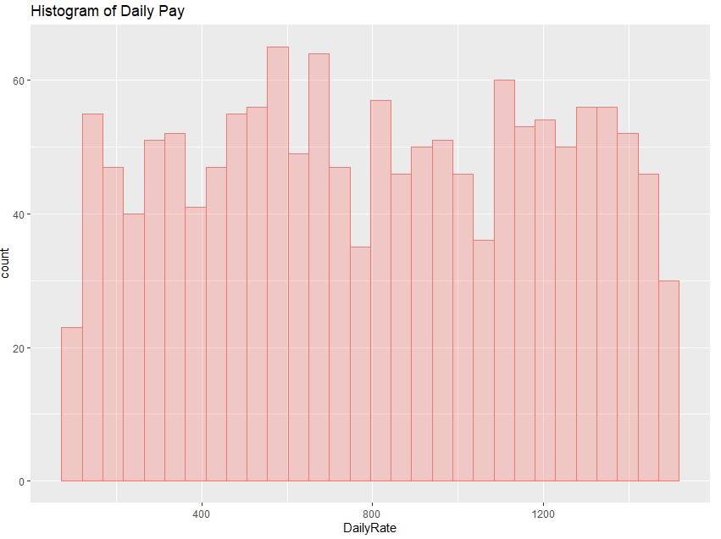
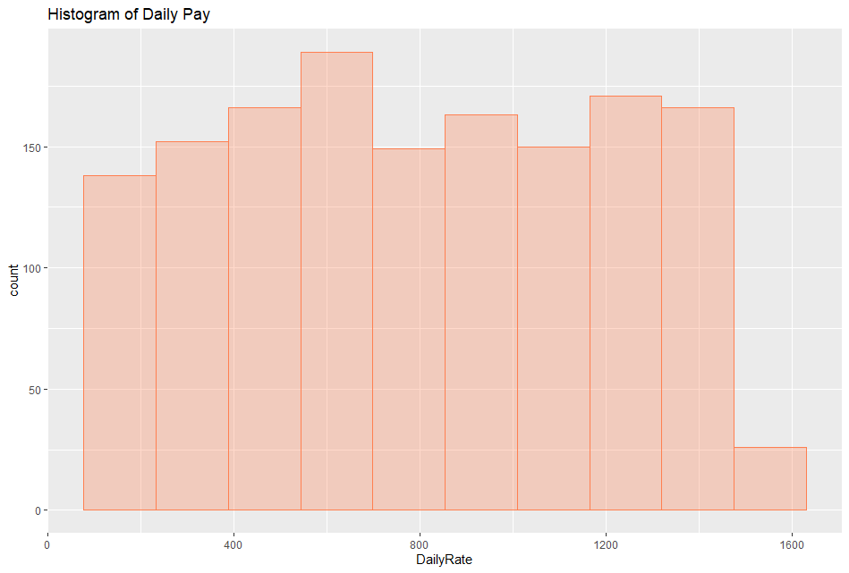
Standards
Visualizing & Plotting Data
Histrograms
Similar to frequency distributions but don’t list each unique value
Group adjacent values instead
Help obscure noise and display trends in data
Choice of “bid-width” and/or interval can provide drastically different results for the same data
Especially with sample size
One of the most commonly-used plots/data viz

Slide 5
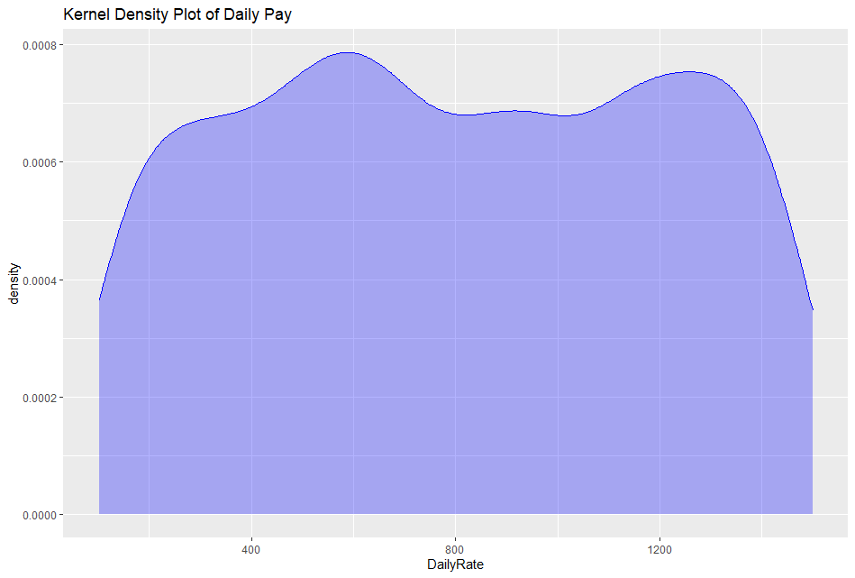
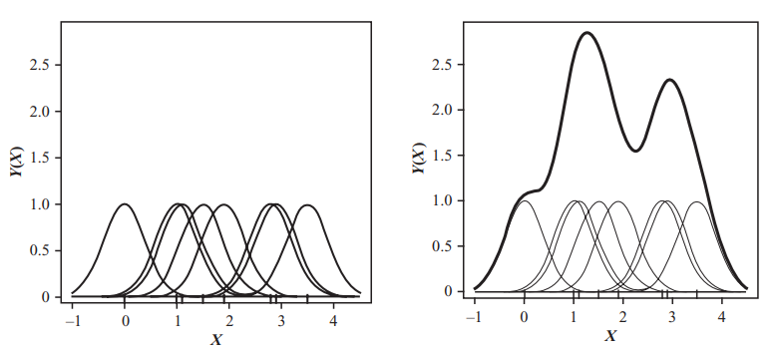
Standards
Visualizing & Plotting Data
Kernel Density Plots
Try to fit a smooth curve to the data values while taking into account random noise
Basic idea is that each actual observations could have been slightly different, and we shouldn’t be overly precise
Daily pay rate could easily be $810 or $820 instead of $815
Random noise shouldn’t be allowed to distort the curve

Slide 6
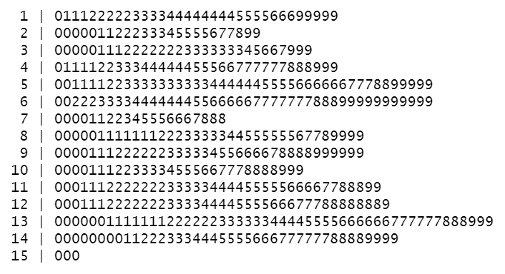
Standards
Stem & Leaf Plot of Daily Pay
Visualizing & Plotting Data
Stem & Leaf Plots
Histograms and KDPs lose actual values, but frequency distributions obscure trends
Stem & Leaf Plots offer a good middle ground where we can see the actual values and overall trends
First digit is the tens digit, or the “leading” digit
Stem
Second digit is the units digit, or the “trailing” digit
Leaves

Slide 7
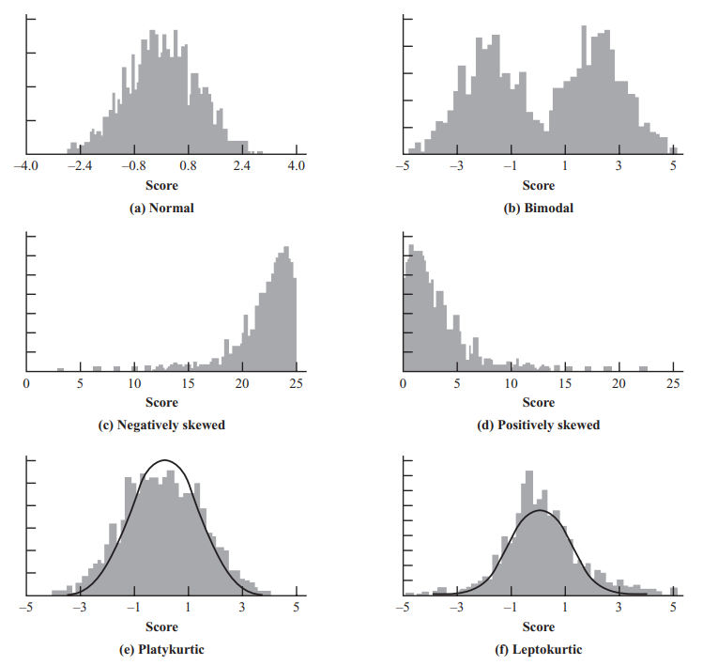
Standards
Describing Data
General Shapes
Number of predominant peaks
Modality
Unimodal, bimodal, multimodal
Symmetry
Same shape on both sides of center or not
Symmetric, positive skew, negative skew
Kurtosis:
Concentration of scores in shoulders or tails
Platykurtic: No tails/bunched in shoulders
Mesokurtic: Normal/well-balanced
Leptokurtic: Fat tails and peakedness

Slide 8
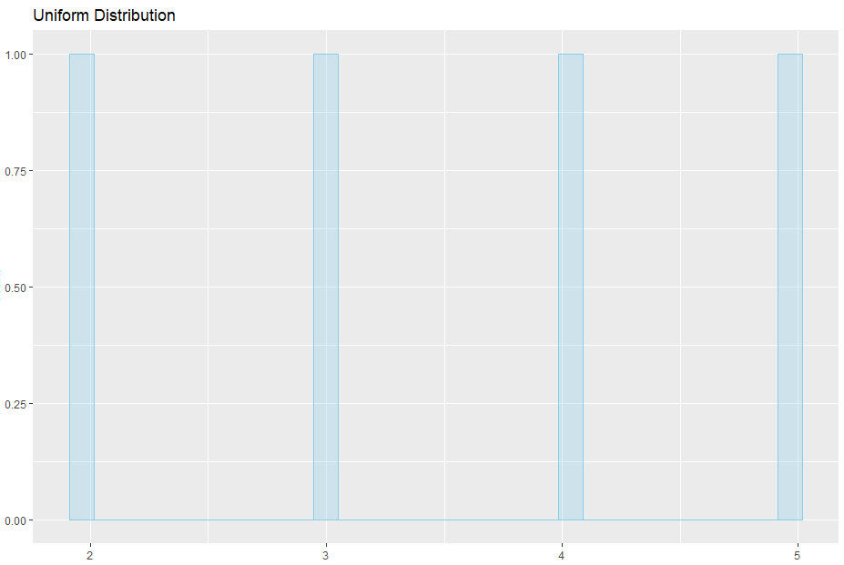

Standards
$$Mean= \overline{X}=\frac{\sum{X}}{N}$$
$$Mean\left(3, 5, 2, 4\right)=\frac{3+5+2+4}{4}=\frac{14}{4}=3.5=\overline{X}$$
$$Median Location= \frac{N+1}{2}$$
$$Median\left(2,3,4,5\right)→Median Location= \frac{4+1}{2}=2.5$$
$$Median\left(2,3,4,5\right)→\left(2, 3\right|4, 5)→Median=3.5$$
$$Mode\left(2,3,4,5\right)→All occur same \# times→Uniform$$
Describing Data
Summary Statistics
Central Tendency
Reflect where on the scale the distribution is centered
Mean
Average
Susceptible to extreme values
Median
Midpoint = 50% of scores fall above or below
Non vulnerable to extreme values
Mode
Most commonly occurring score
Always a value that actually occurred

Slide 9
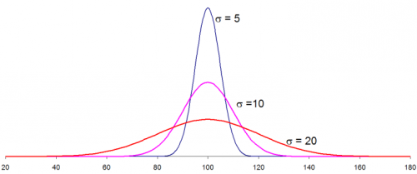
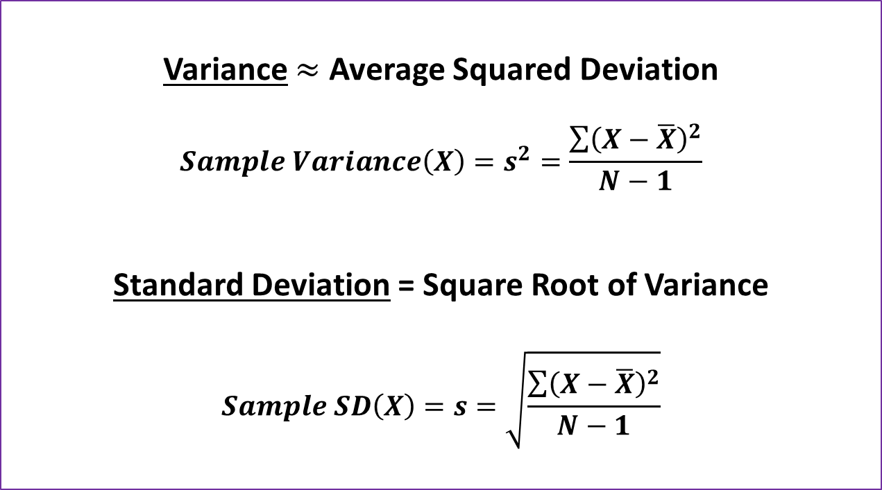
Standards
Describing Data
Variance $≈$ Average Squared Deviation
$$Sample Variance\left(X\right)=s^{2}=\frac{\sum{{\left(X−\overline{X}\right)}^{2}}}{N−1}$$
Standard Deviation = Square Root of Variance
$$Sample SD\left(X\right)=s=\sqrt{\frac{\sum{{\left(X−\overline{X}\right)}^{2}}}{N−1}}$$
Summary Statistics
Variability
Reflects how much the observations deviate from their average
Sometimes scores may be clustered around their average
Average does reflect the general location of the scores
Low Variance/Standard Deviation
Sometimes scores may be distributed over a wide range
Average won’t be very representative of the full set of scores
High Variance/Standard Deviation
Variance and SD are very susceptible to extreme values
Distributions with Varying Standard Deviations $(σ=5, 10, 20)$

Slide 10
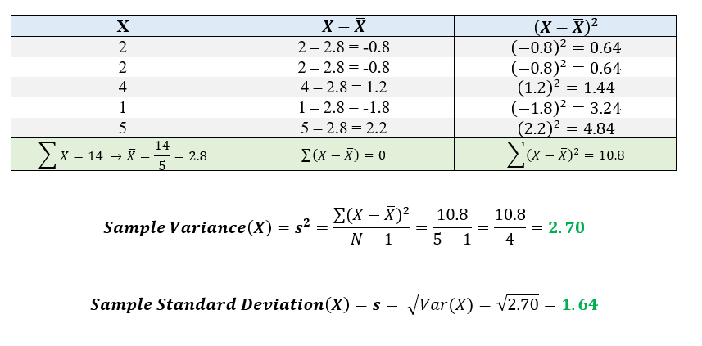
Calculating the Sample Variance and Standard Deviation

Slide 11
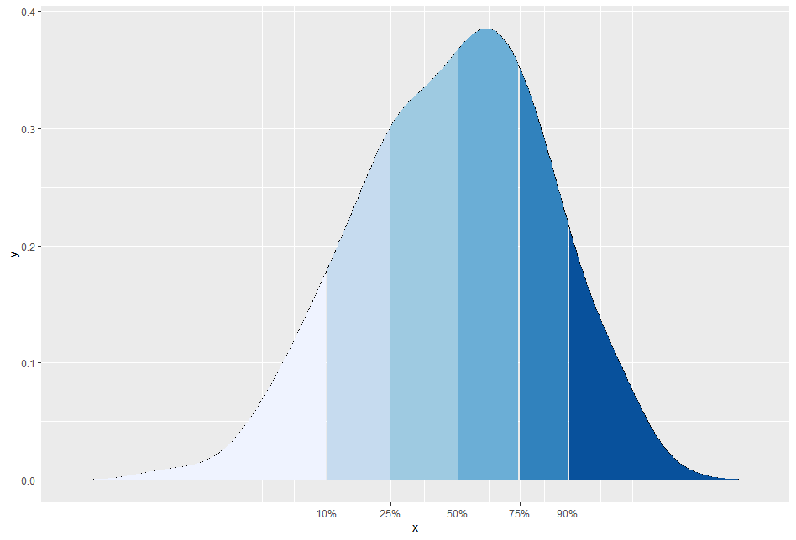
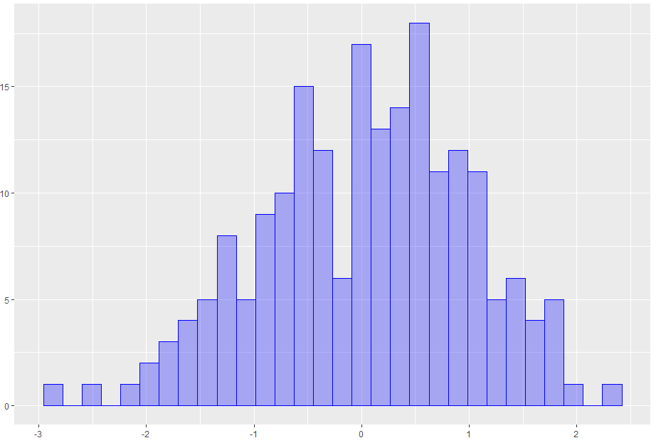
Standards
Describing Data
Summary Statistics
Quantiles & Percentiles
Quantiles
Order values from small to large and split data into n equal pieces
For n equal pieces, we use n-1 cut points equally spaced out
Quartiles split the data into 4 equal pieces
We use 3 cut points
Quartile 1 = 25%, Quartile 2 = 50%, Quartile 3 = 75%
Percentiles split the data into 100 equal pieces
We use 99 cut points

Slide 12
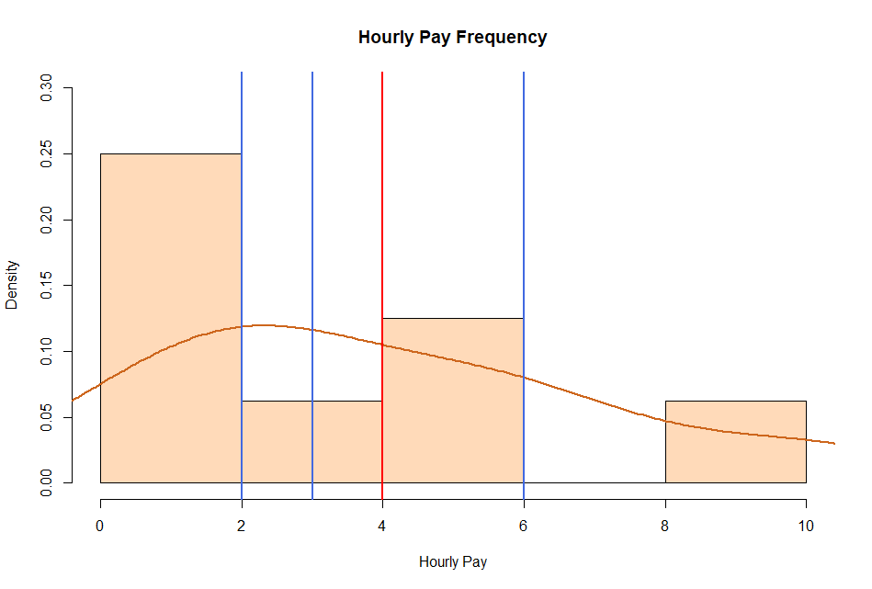
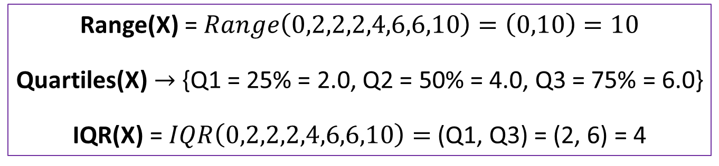
Standards
Describing Data
Range(X) = $Range\left(0,2,2,2,4,6,6,10\right)=\left(0,10\right)=10$
Quartiles(X) $→$ {Q1 = 25% = 2.0, Q2 = 50% = 4.0, Q3 = 75% = 6.0}
IQR(X) = $IQR\left(0,2,2,2,4,6,6,10\right)=$ (Q1, Q3) = (2, 6) = 4
Summary Statistics
Range & IQR
Range
Measure of distance from lowest to highest score
Suffers heavily from extreme scores
You can have 1,000 values ranging between (0, 1) but just one value of 100 changes the range to (0, 100)
Quartiles: Points that cut off the lower 25%, 50%, 75%, 100%
Interquartile Range
Measure of distance from 25th percentile to 75th percentile
Quartile 1 (Q1) to Quartile 3 (Q3) = Middle 50% of scores
Attempts to circumvent heavy dependence of range on extreme scores
Q2 = 50%
Q1 = 25%
Mean
Q3 = 75%

Slide 13
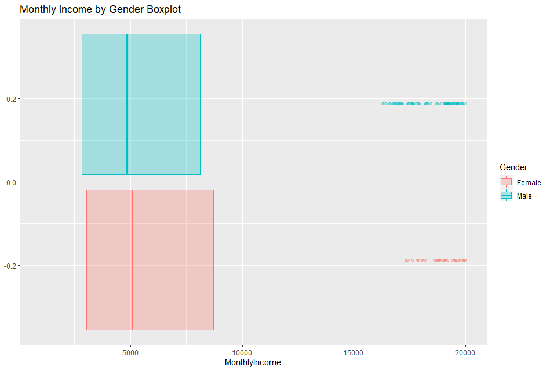
Standards
Describing Data
Visualizing Summary Statistics
Boxplots
Skewed Data Boxplot
Data visualization that gives greater prominence to spread
Box = IQR = Middle 50% = {Q1, Q3} = {25th%, 75th%}
Middle line = Median = Q2 = {50th%}
Inner Fences = {(Q1 - 1.5*IQR), (Q3 + 1.5*IQR)}
Adjacent Values = actual points no more extreme than inner fences
Lower Adjacent Value = smallest value above lower fence
Upper Adjacent Value = greatest value below upper fence
Whiskers = (Q1 to Lower Adj. Value) and (Q3 to Upper Adj. Value)
Outliers = All points more extreme than adjacent values
Q1 = 25%
Q3 = 75%
Upper Adjacent
Q2 = 50%
Outliers
Q1 = 25%
Q3 = 75%
Upper Adjacent
Q2 = 50%
Outliers

Slide 14
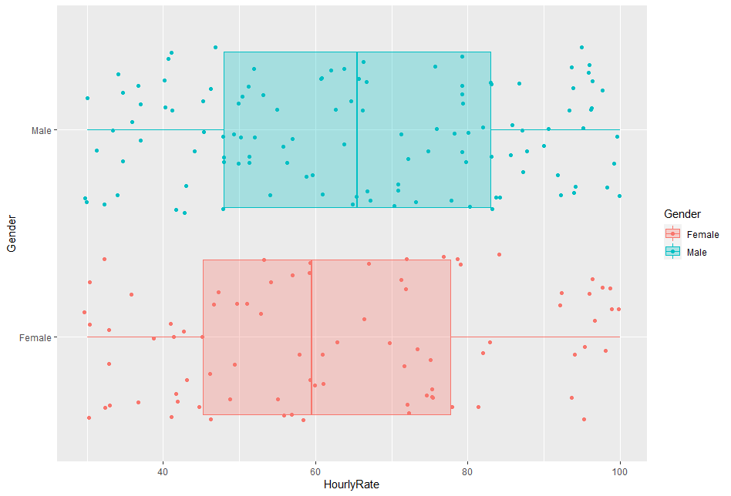
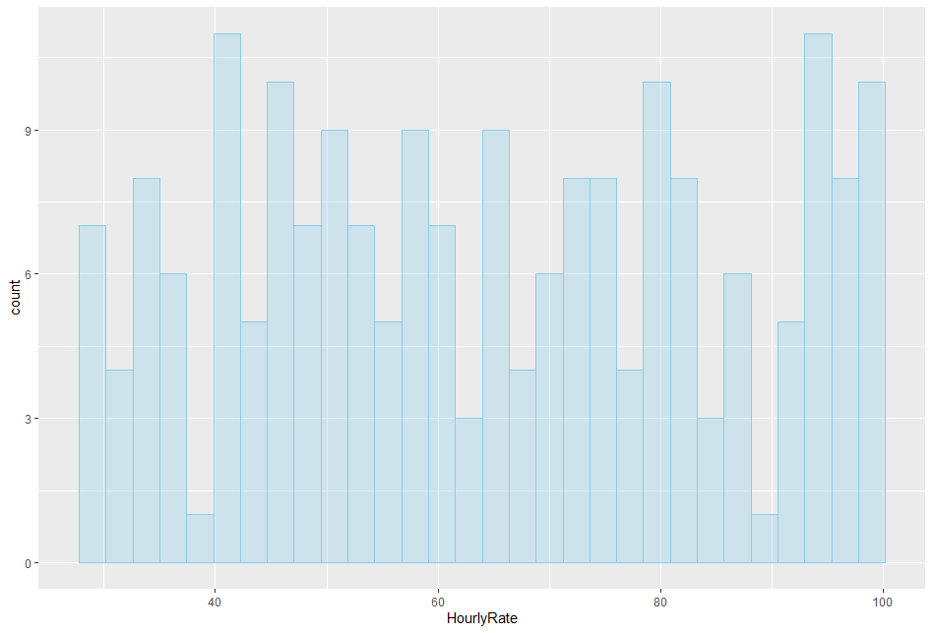
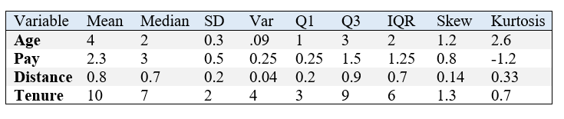
Describing and Exploring Data Recap
Goal
Describe the variables in our sample data through visualizations and summary statistics
Visualize
Frequency Distributions
Histograms
Density Plots
Stem & Leaf Plots
Boxplots
Summarize
Central Tendency
Mean, Median, Mode
Variability & Spread
Variance, Standard Deviation
Range & Interquartile Range
Symmetry
Skew
Kurtosis

